Slide 1
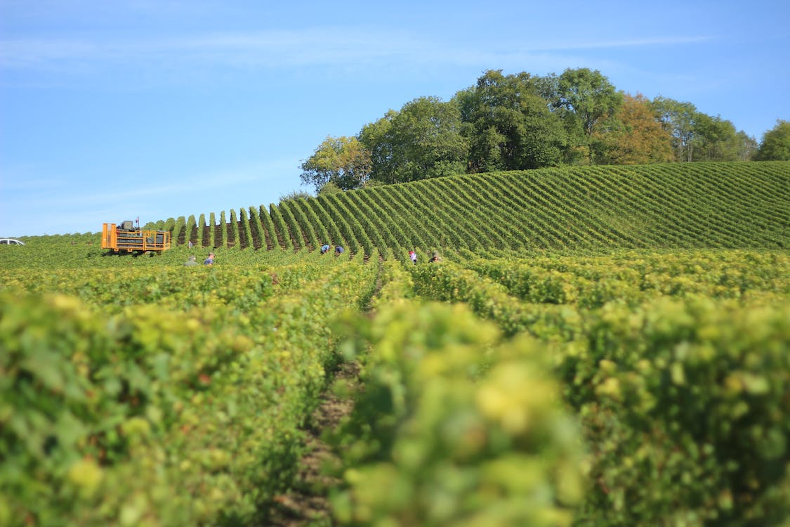



Slide 2
Capstone Project
Tran Dang Khoa - 19110145
Pham Viet Nam – 19110151 Nguyen Le Minh Nhut - 19110100

Slide 3
1. PROJECT OVERVIEW
2. THE EXPECTATION
3. SYSTEM DESIGN
4. DEMO
5. SUMMARY

Slide 4
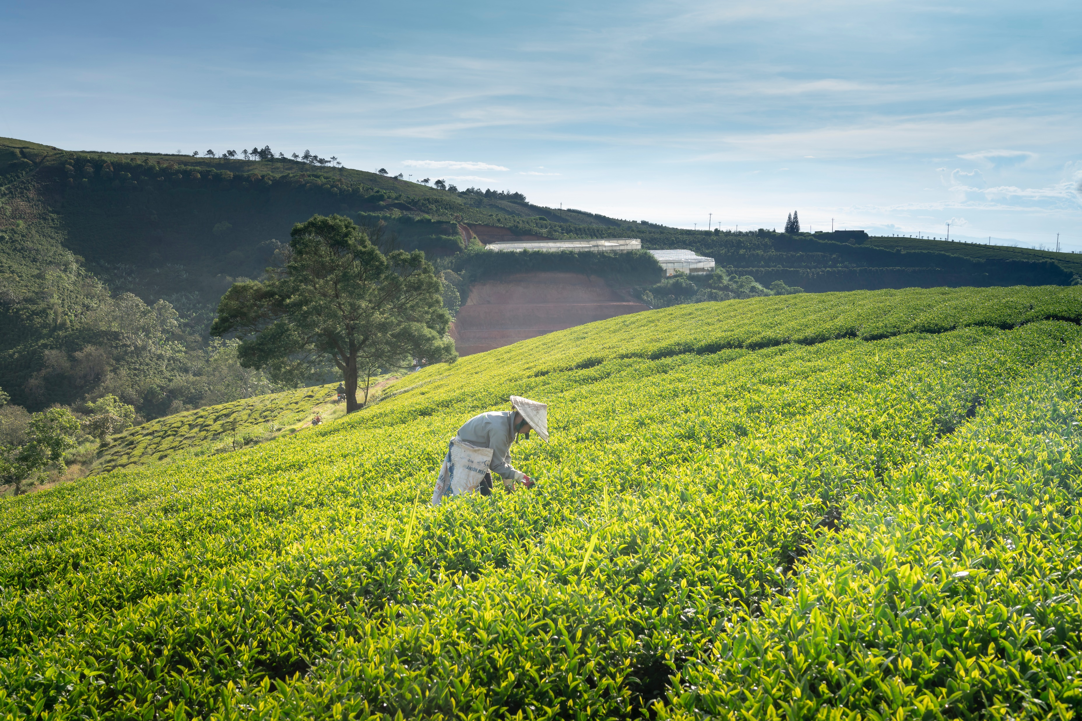


The urgency of the project
Agriculture is an important sector in the economy.
Technology has brought new opportunities for the agricultural industry.
The adoption of new technologies improves efficiency and product quality.
It helps reduce risks and costs associated with agricultural production.
New technologies enable farmers to expand their businesses.
Farmers can reach a wider audience and promote their agricultural products.
SYSTEM OF BUYING AND SELLING AGRICULTURAL PRODUCTS
FARMHOME

Slide 5


By leveraging technology to build an e-commerce platform, the following objectives can be achieved:
Optimize the process of agricultural product consumption between traders and farmers.
Simplify and enhance the commercial value by developing mobile applications that allow agricultural producers to directly interact with commercial partners and consumers.
Reduce intermediaries in the trading process, facilitating direct connections between traders and farmers.
The urgency of the project
SYSTEM OF BUYING AND SELLING AGRICULTURAL PRODUCTS
Agriculture is an important sector in the economy.
Technology has brought new opportunities for the agricultural industry.
The adoption of new technologies improves efficiency and product quality.
It helps reduce risks and costs associated with agricultural production.
New technologies enable farmers to expand their businesses.
Farmers can reach a wider audience and promote their agricultural products.
FARMHOME
THE OBJECTIVES

Slide 6


By leveraging technology to build an e-commerce platform, the following objectives can be achieved:
Optimize the process of agricultural product consumption between traders and farmers.
Simplify and enhance the commercial value by developing mobile applications that allow agricultural producers to directly interact with commercial partners and consumers.
Reduce intermediaries in the trading process, facilitating direct connections between traders and farmers.
The urgency of the project
SYSTEM OF BUYING AND SELLING AGRICULTURAL PRODUCTS
Agriculture is an important sector in the economy.
Technology has brought new opportunities for the agricultural industry.
The adoption of new technologies improves efficiency and product quality.
It helps reduce risks and costs associated with agricultural production.
New technologies enable farmers to expand their businesses.
Farmers can reach a wider audience and promote their agricultural products.
FARMHOME
THE OBJECTIVES
THE EXPECTATION
*Object and scope of the study
The main points can be summarized as follows:
The investigation involved two focus groups: one with prior knowledge of technology and one without.
The research covered various technical knowledge areas, including Angular, React Native, MySQL database, Spring Boot, and a brief application on TensorFlow.
The study aimed to outline the main objectives and apply the knowledge points to the final product, without focusing extensively on irrelevant theories.

Slide 7




THE EXPECTATION
*Object and scope of the study
By leveraging technology to build an e-commerce platform, the following objectives can be achieved:
Optimize the process of agricultural product consumption between traders and farmers.
Simplify and enhance the commercial value by developing mobile applications that allow agricultural producers to directly interact with commercial partners and consumers.
Reduce intermediaries in the trading process, facilitating direct connections between traders and farmers.
The main points can be summarized as follows:
The investigation involved two focus groups: one with prior knowledge of technology and one without.
The research covered various technical knowledge areas, including Angular, React Native, MySQL database, Spring Boot, and a brief application on TensorFlow.
The study aimed to outline the main objectives and apply the knowledge points to the final product, without focusing extensively on irrelevant theories.
THE OBJECTIVES
EXPECTED RESULTS
Topic “BUILD A SYSTEM TO TRADE AGRICULTURAL PRODUCTS” serves following purposes:
Building a website for farmers can management their products as well as orders.
Building a mobile application for merchants can find and trade agricultural products with farmers.
Building a data management website for admin.
Building a system of buying and selling agricultural products between merchants and farmers with a user-friendly interface, easy to use.

Slide 8
THE EXPECTATION
*Object and scope of the study
EXPECTED RESULTS
The main points can be summarized as follows:
The investigation involved two focus groups: one with prior knowledge of technology and one without.
The research covered various technical knowledge areas, including Angular, React Native, MySQL database, Spring Boot, and a brief application on TensorFlow.
The study aimed to outline the main objectives and apply the knowledge points to the final product, without focusing extensively on irrelevant theories.
Topic “BUILD A SYSTEM TO TRADE AGRICULTURAL PRODUCTS” serves following purposes:
Building a website for farmers can management their products as well as orders.
Building a mobile application for merchants can find and trade agricultural products with farmers.
Building a data management website for admin.
Building a system of buying and selling agricultural products between merchants and farmers with a user-friendly interface, easy to use.

Slide 9
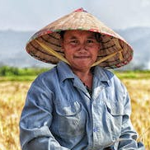

Login to the website
Add agricultural products
Farmers
Receive orders
History
Accept
Decline
Done
Orders
Discuss
Create orders
Find agricultural products
New request
Merchant
Login to the mobile app

Slide 10
MERCHANT
FARMER
- Login/Register
- Manage profile
- View the list of agricultural products
- View the farmers
- Search
- Orders
- Decision final deal price (if have)
- Delete the ordered agricultural product
- See the list of ordered agricultural products
- Login/Register
- Manage profile
- Manage agricultural products
- Validate agricultural orders (Accept/Discuss/Decline)
- View agricultural products’ orders
- Deal new agricultural products’s price
ACTORS AND USECASES

Slide 11
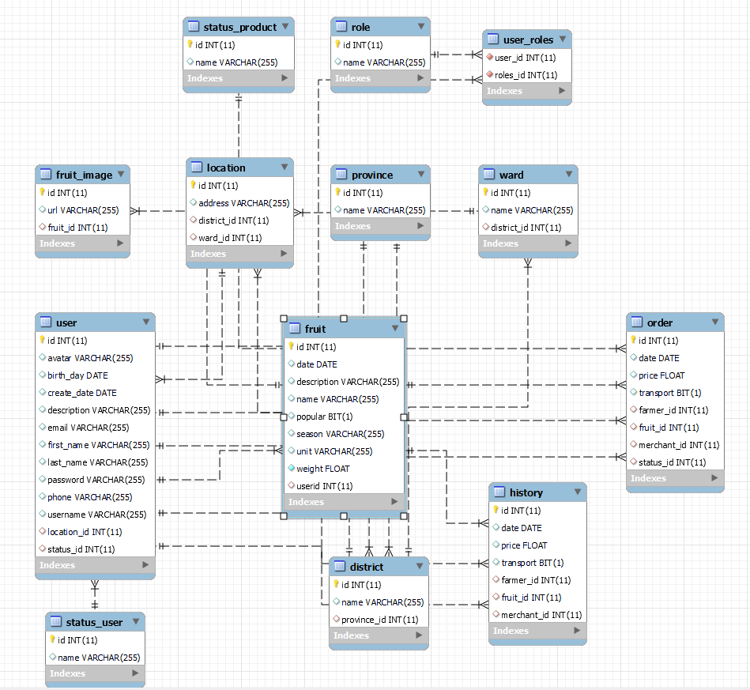
DATABASE

Slide 12

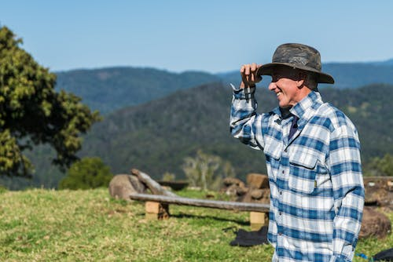
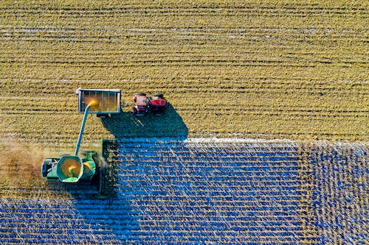
Demo
FARMHOME

Slide 13
ACHIEVED RESULT
About knowledge and skills:
Backend development with Java, Spring Boot, and Python enables API creation for frontend and mobile applications, covering programming concepts, web development skills, and database connectivity. Students also gain knowledge in deployment, cloud platforms, machine learning/AI, and debugging.
The system utilizes JavaScript, Typescript, SASS/SCSS, React JS, React Native, and Angular with material design to develop dynamic admin pages, farmer websites, and merchant mobile apps. Students learn fundamental concepts of these technologies, including syntax, DOM manipulation, asynchronous operations, and user interactions, while leveraging libraries like Axios and Redux for enhanced functionality and emphasizing effective debugging for troubleshooting.

Slide 14
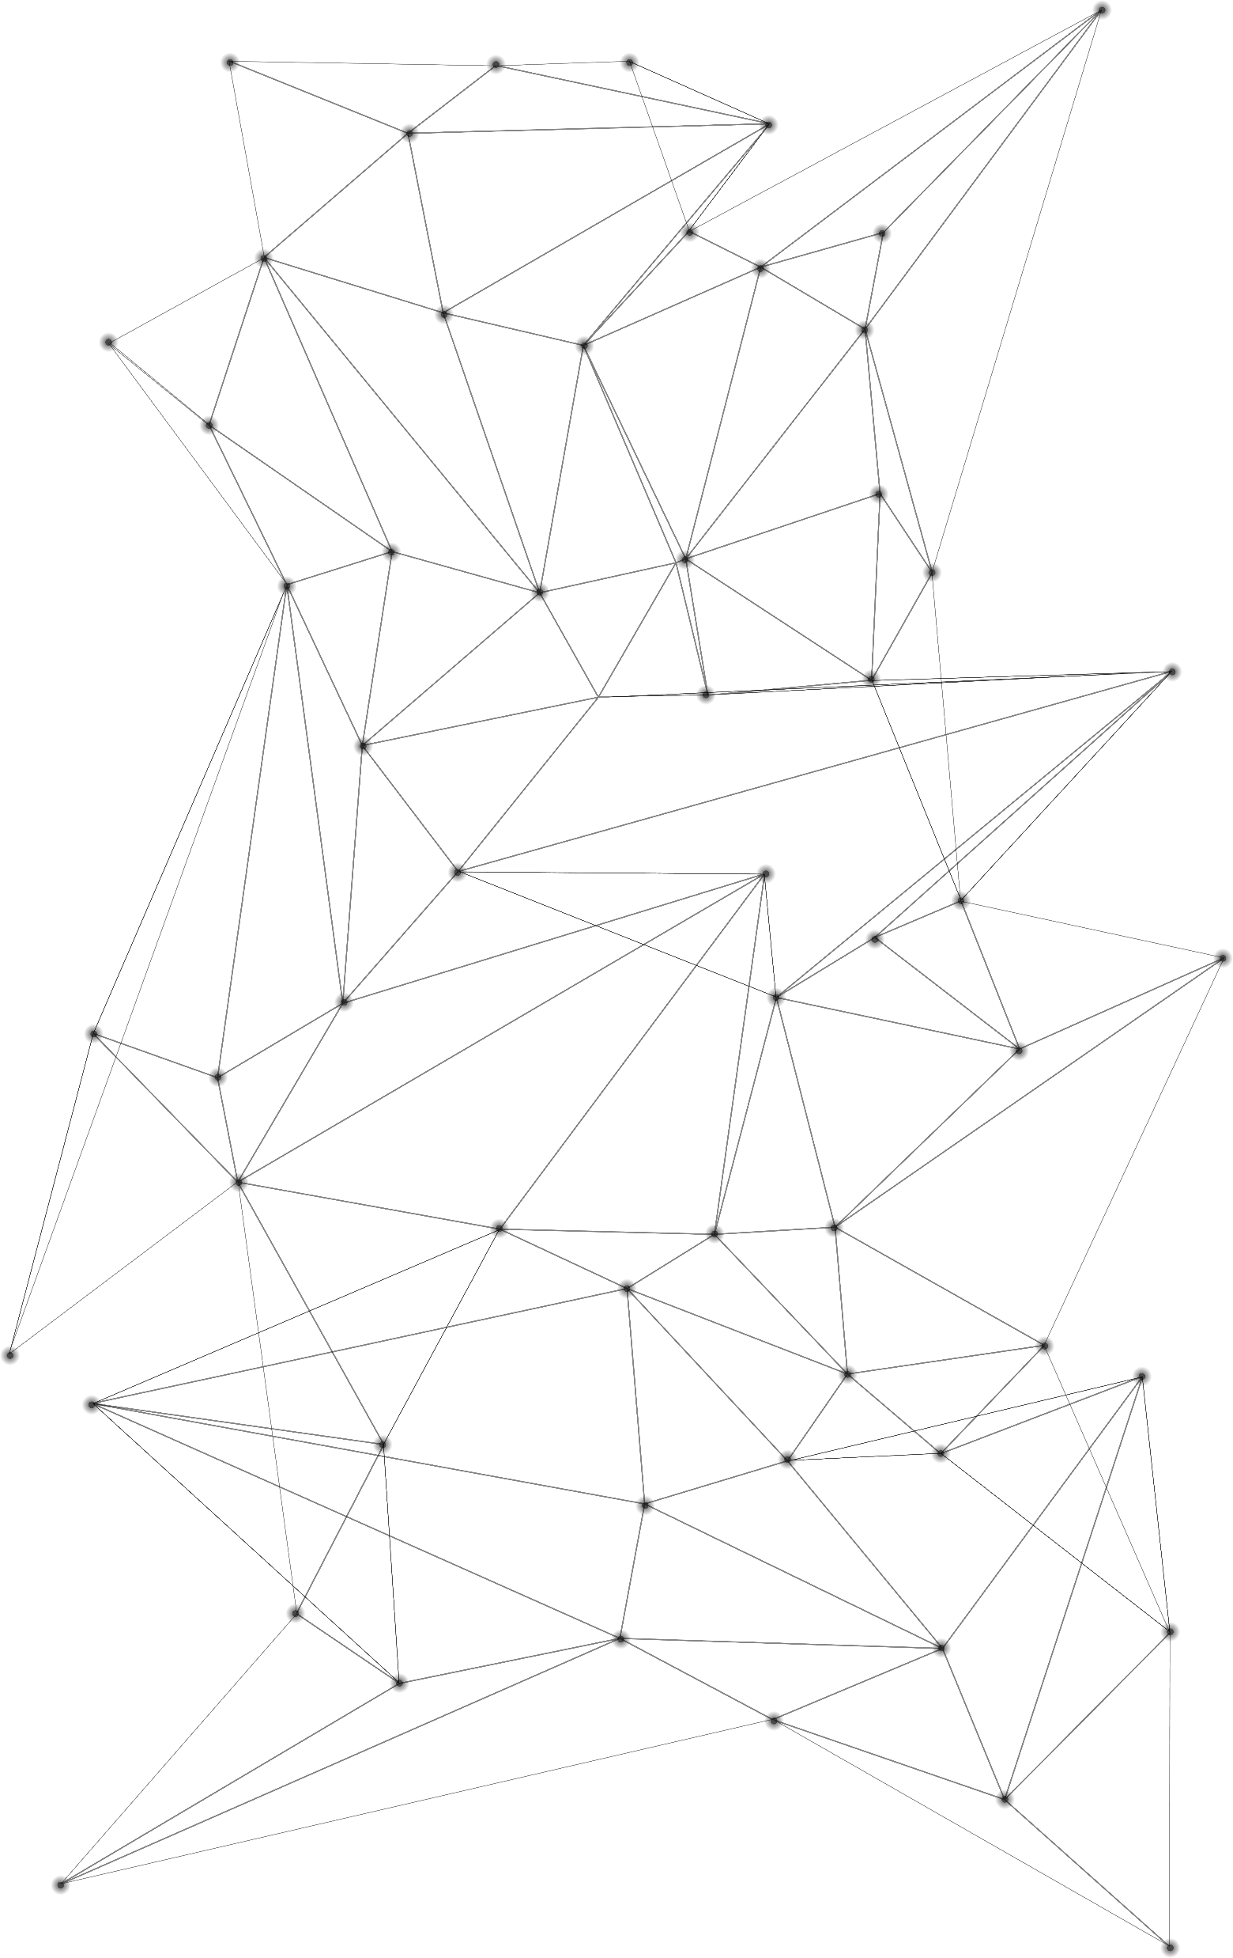

ACHIEVED RESULT
About topic:
The backend program ensures the fulfillment of required APIs for frontend and mobile applications.
The admin website includes features for user monitoring, management, product and category management, and sales data analytics.
The mobile app caters to merchants, allowing them to view and order products, as well as access additional features like chat, information updates, and news reading. Notifications are sent for important events.
The website supports farmers in managing agricultural products and orders. Users can log in, update product information, and handle orders, including viewing and confirming them.
About knowledge and skills:
Backend development with Java, Spring Boot, and Python enables API creation for frontend and mobile applications, covering programming concepts, web development skills, and database connectivity. Students also gain knowledge in deployment, cloud platforms, machine learning/AI, and debugging.
The system utilizes JavaScript, Typescript, SASS/SCSS, React JS, React Native, and Angular with material design to develop dynamic admin pages, farmer websites, and merchant mobile apps. Students learn fundamental concepts of these technologies, including syntax, DOM manipulation, asynchronous operations, and user interactions, while leveraging libraries like Axios and Redux for enhanced functionality and emphasizing effective debugging for troubleshooting.
STRENGTHS
The system incorporates seamless file uploading, internet-based hosting, an agricultural detection model, and thorough error testing.
The interface is improved based on instructor feedback for wider user suitability. Statistical indicators are carefully sourced and consulted with experts. Optimizing simple functions maximizes efficiency and effectiveness.
Contains the basic functions used for trading argicultural products in the “Merchant” and “Farmer” side.

Slide 15
ACHIEVED RESULT
STRENGTHS
About topic:
The backend program ensures the fulfillment of required APIs for frontend and mobile applications.
The admin website includes features for user monitoring, management, product and category management, and sales data analytics.
The mobile app caters to merchants, allowing them to view and order products, as well as access additional features like chat, information updates, and news reading. Notifications are sent for important events.
The website supports farmers in managing agricultural products and orders. Users can log in, update product information, and handle orders, including viewing and confirming them.
The system incorporates seamless file uploading, internet-based hosting, an agricultural detection model, and thorough error testing.
The interface is improved based on instructor feedback for wider user suitability. Statistical indicators are carefully sourced and consulted with experts. Optimizing simple functions maximizes efficiency and effectiveness.
Contains the basic functions used for trading argicultural products in the “Merchant” and “Farmer” side.

Slide 16
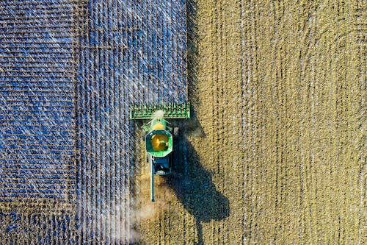
STRENGTHS
There will be some functions that used to support for the trading.
Collecting data to show the price to the users so thay can know about the price in the market right now.
Notifications will be sent to the user’s phone to make sure they will notice when there is an event to their orders.
Fruit detection helps users identify different types of fruits, facilitating the easy recording of information through images using a pre-trained model.
The system incorporates seamless file uploading, internet-based hosting, an agricultural detection model, and thorough error testing.
The interface is improved based on instructor feedback for wider user suitability. Statistical indicators are carefully sourced and consulted with experts. Optimizing simple functions maximizes efficiency and effectiveness.
Contains the basic functions used for trading argicultural products in the “Merchant” and “Farmer” side.
DRAWBACKS
The current system lacks some features such as messages, language switching, notification on the website, not support for IOS right now in mobile, social media login, etc…
The application's lack of optimization can lead to suboptimal access speed and potential errors due to inadequate scalability for high-frequency and large-scale usage.
Errors can be partially resolved through frontend self-adjustment, but complete autonomous resolution is lacking. The machine learning model used for classification may misclassify new agricultural products.

Slide 17
DRAWBACKS
STRENGTHS
The current system lacks some features such as messages, language switching, notification on the website, not support for IOS right now in mobile, social media login, etc…
The application's lack of optimization can lead to suboptimal access speed and potential errors due to inadequate scalability for high-frequency and large-scale usage.
Errors can be partially resolved through frontend self-adjustment, but complete autonomous resolution is lacking. The machine learning model used for classification may misclassify new agricultural products.
There will be some functions that used to support for the trading.
Collecting data to show the price to the users so thay can know about the price in the market right now.
Notifications will be sent to the user’s phone to make sure they will notice when there is an event to their orders.
Fruit detection helps users identify different types of fruits, facilitating the easy recording of information through images using a pre-trained model.

Slide 18
FUTURE DEVELOPMENTS
Improve the limitations that have not been reached.
To accommodate future development, potential APIs can be integrated to introduce functionalities like social media login, rating, commenting, and more.
Introducing a super admin role to facilitate systematic management of other admins would be a valuable improvement.
Creating a better bussiness for circulation economy (solutions for farmer to solve the bad harvest problems, solving the damaged products problems)
Suppoting for more options when delivering (providing warehouses for merchant to save, choosing a third-party delivering service)
DRAWBACKS
In real-world scenarios, there may be instances where certain features are missing or insufficient, which can present challenges for users.
Limited advanced permission management features may compromise system security and control by hindering effective user role and access level management.
The absence of a dedicated reference price management feature for farmers complicates the process of setting competitive prices based on reliable market references.

Slide 19

FUTURE DEVELOPMENTS
Improve the limitations that have not been reached.
To accommodate future development, potential APIs can be integrated to introduce functionalities like social media login, rating, commenting, and more.
Introducing a super admin role to facilitate systematic management of other admins would be a valuable improvement.
Creating a better bussiness for circulation economy (solutions for farmer to solve the bad harvest problems, solving the damaged products problems)
Suppoting for more options when delivering (providing warehouses for merchant to save, choosing a third-party delivering service)
DRAWBACKS
In real-world scenarios, there may be instances where certain features are missing or insufficient, which can present challenges for users.
Limited advanced permission management features may compromise system security and control by hindering effective user role and access level management.
The absence of a dedicated reference price management feature for farmers complicates the process of setting competitive prices based on reliable market references.

